Slide 1
Introduction to Developing Interactive Web Applications with Shiny in R
Johnathan Evanilla
Tandy Center for Ocean Forecasting, Bigelow Laboratory for Ocean Sciences
Community Engaged Data Science, College of the Atlantic
23 May 2024

Slide 2
Workshop Outline
Introductions (you + me)
Coding
Hello Shiny; Inputs + Outputs
Reactivity
Extra tools
Sharing
Project work / Open Q+A (if there’s time)

Slide 3
Introductions

Slide 4
Introductions
Community Engaged Data Science Projects (2-3 min)
Briefly describe your project
What’s the goal? Who are you engaging with? Challenges?
Maine R User Group
Where in Maine are you?
What do you use R for?

Slide 5

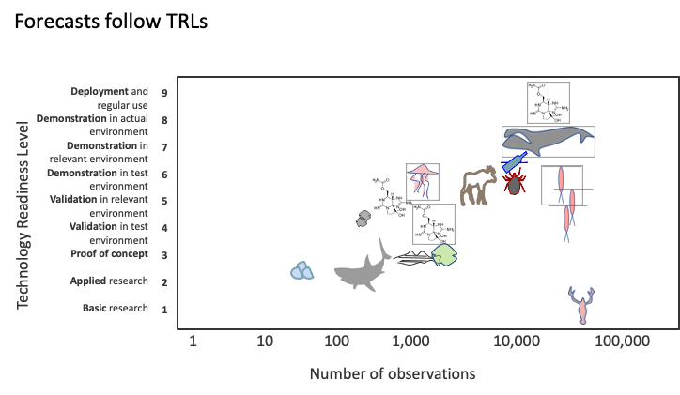

Tandy Center for Ocean Forecasting
Data technician position opening this summer.
Email: nrecord@bigelow.org

Slide 6
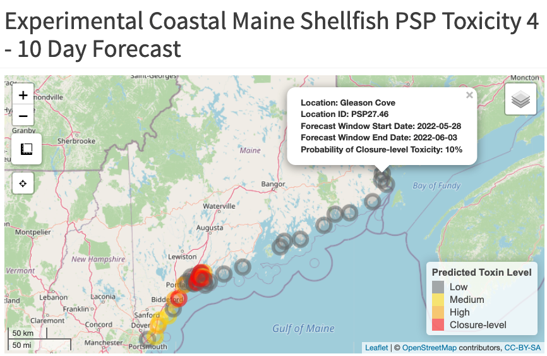
How we use Shiny
No longer available – Added to Maine DMR Shellfish Closure Map for 2024

Slide 7
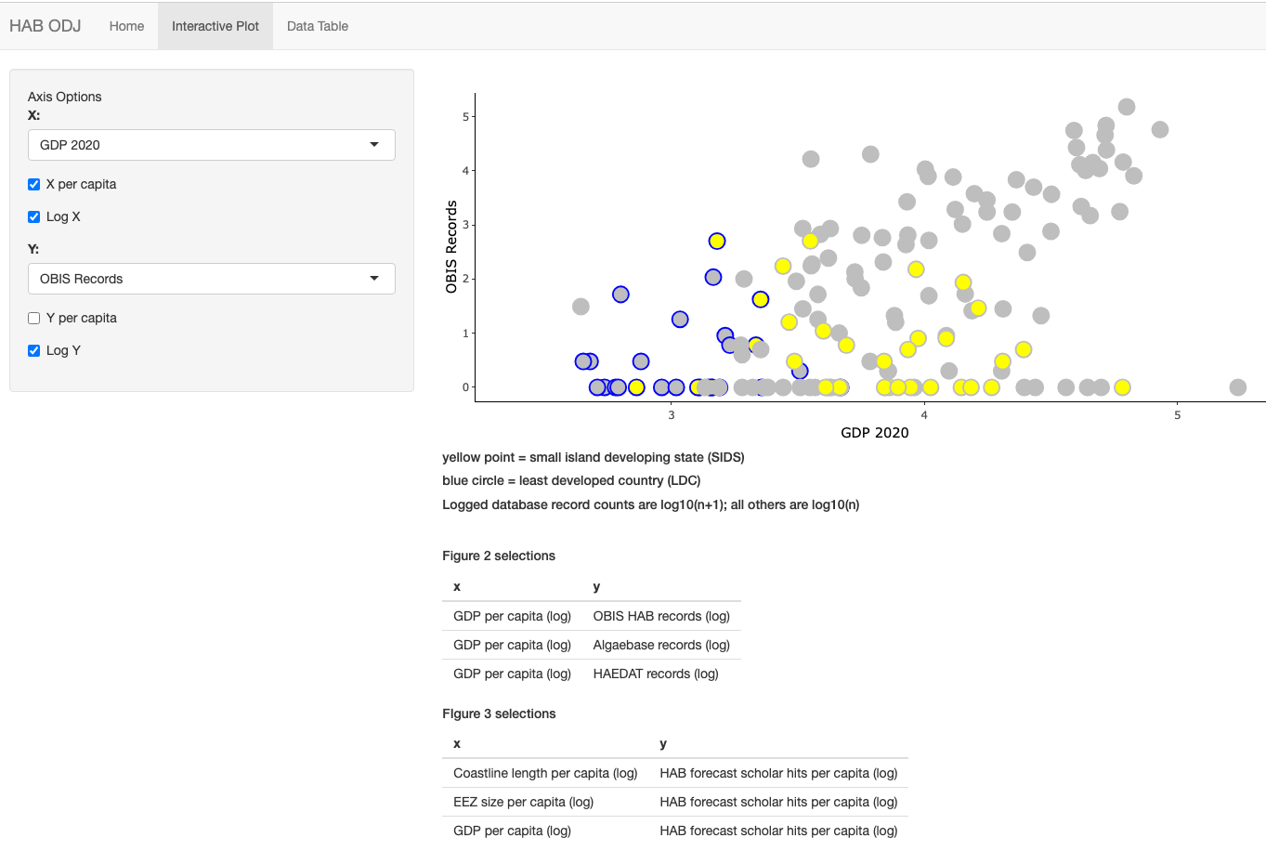

How we use Shiny
Harmful Alagal Bloom –
Ocean Data Justice
https://jevanilla.shinyapps.io/habodj/

Slide 8

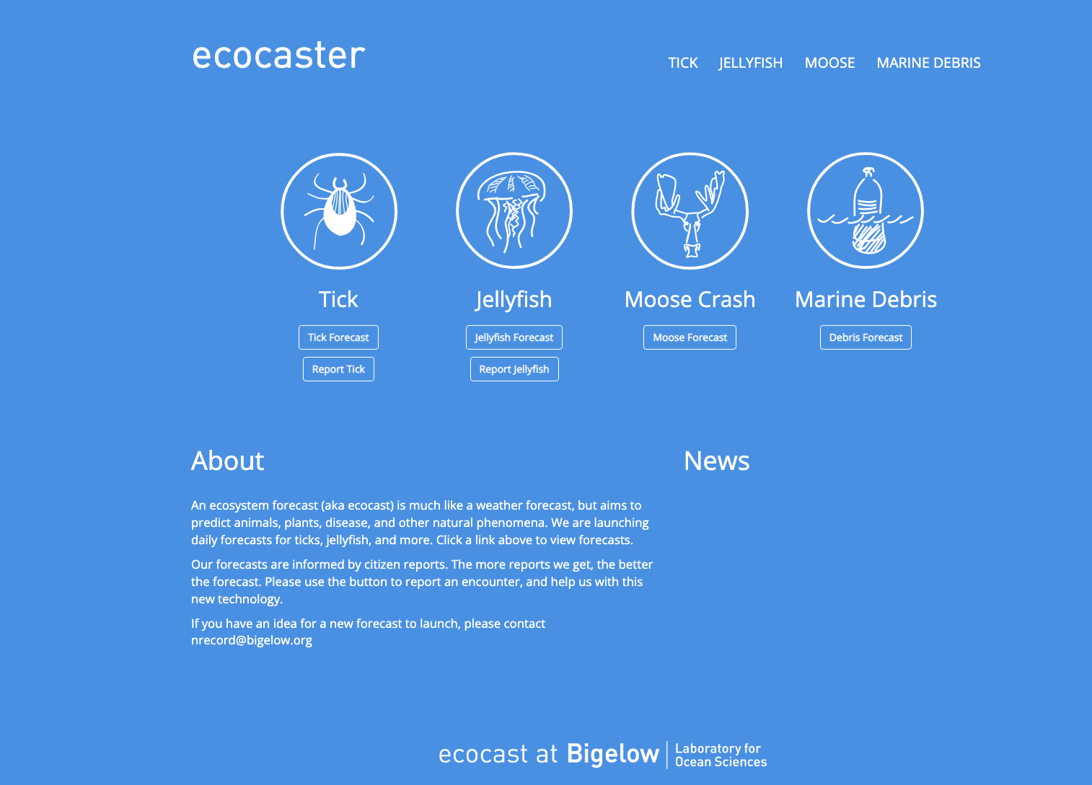
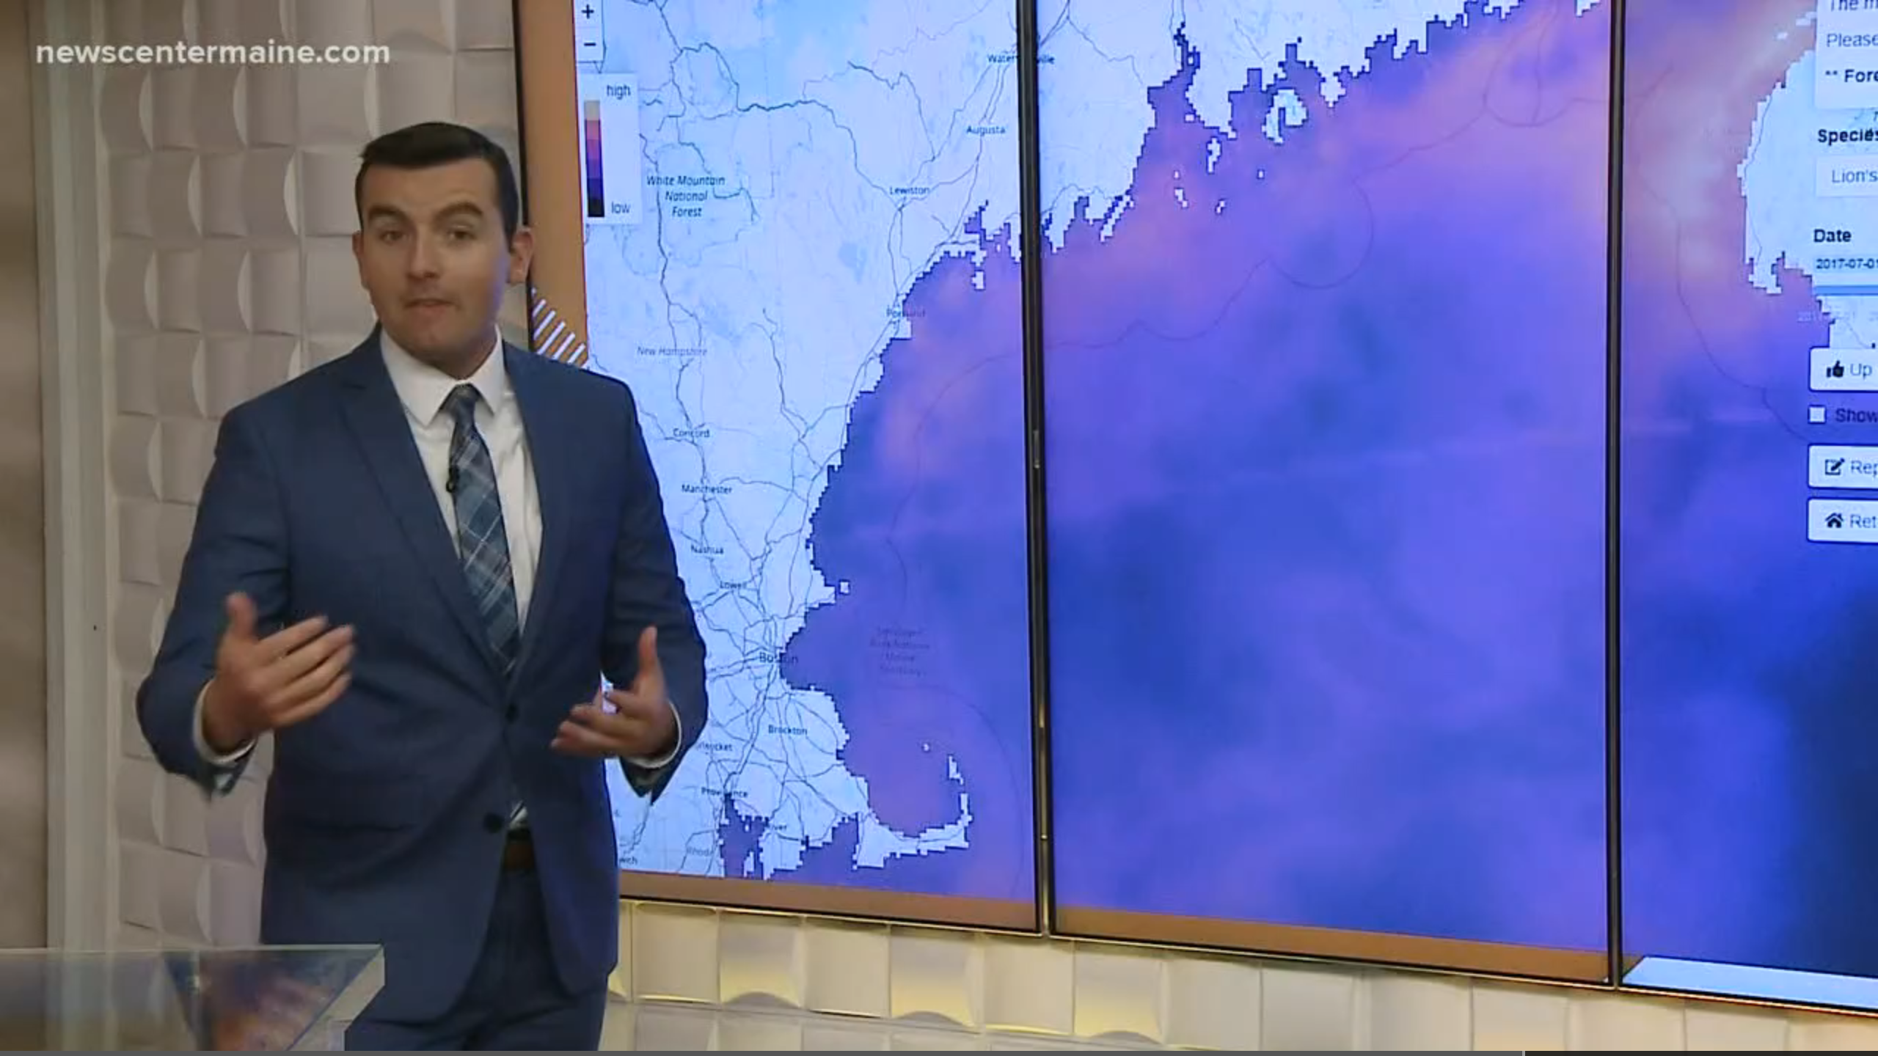
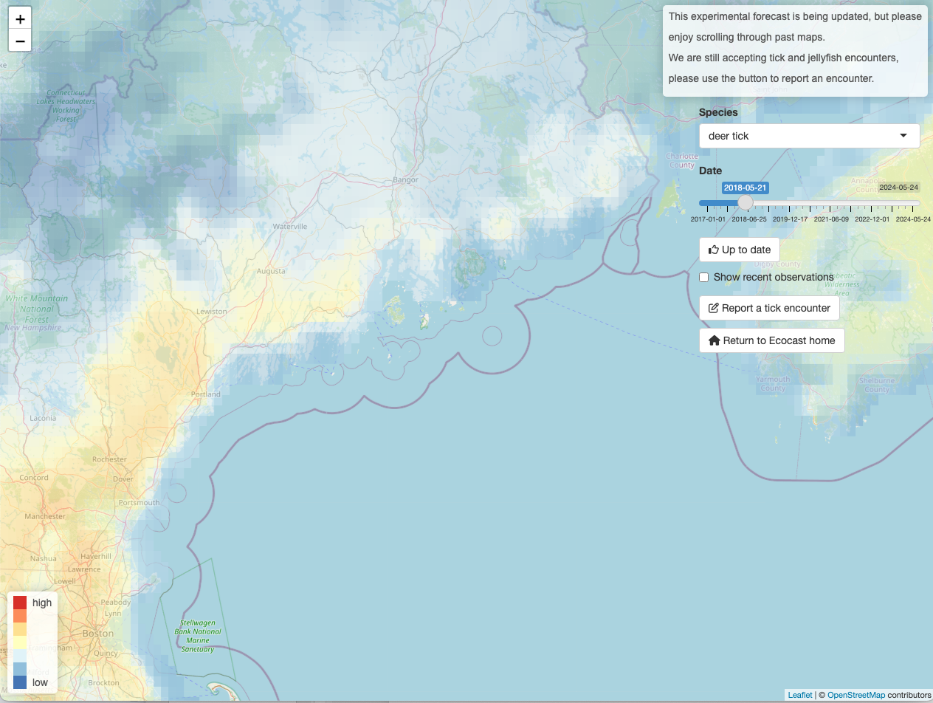
How we use Shiny
https://eco.bigelow.org/

Slide 9
Hello Shiny

Slide 10
Inputs + Outputs

Slide 11
Inputs
Family of functions that follow {type}Input()
For example textInput() for collecting text
First argument is always an input ID
Second argument is a label
Refer to inputs in the server using input${ID}

Slide 12
Outputs
Defined by output$ID in the server
Family of output functions that follow:
Server: render{type}()
UI: {type}Output(“id”)
For example: renderText() -> textOutput()

Slide 13
Reactivity

Slide 14
Reactive Expressions
Takes an input and returns a value
Cache their value to reduce computation
Can be called elsewhere (like a function)
Use the function `name`<- reactive({})
Reduces duplicate code
Name()

Slide 15
React Based on Event
Reactive expression triggered by an event
(ie recalculate a value)
Use eventReactive(input, {})
Perform an action in response to an event
(ie update something in the UI)
Use observeEvent(input, {})

Slide 16
Dynamic UI
Updating your UI using reactive expressions
Family of functions: update{InputType}
For example: updateSelectInput()
Use similar syntax as {type}Input()functions

Slide 17
Tidy Evaluation
R recognizes the difference between .env vs .data variables
x <- “count”
mutate(df, x*10)
mutate(df, .data$x*10)
Shiny context
.data[[input${name}]]

Slide 18
Extras

Slide 19
Layouts
One page Layout functions:
sidebarLayout()
Use sidebarPanel() + mainPanel()
fluidRow()
Use column(width=n) where: n < 13
Multi page
tabsetPanel(), navlistPanel(), navbarPage()
All use tabPanel() inside for each tab

Slide 20
Publishing a Shiny App

Slide 21
Sharing a Shiny App
With other R users
Share the code (github, zip file, etc.)
Use shiny::runGitHub(repo, username)
Or shiny::runGist() to keep things anonymous
Publishing as a web page
Shinyapps.io
Private server
Posit connect

